Slide 1
Hotel Reservation Analysis
By Md Al Hasib Faisal

Slide 2
Purpose
This analysis was conducted to gain a comprehensive understanding of our hotel's reservation patterns and trends. By examining various aspects of the booking process, we aim to identify opportunities for optimizing occupancy rates, enhancing customer satisfaction, and increasing overall revenue. This analysis also seeks to uncover key insights into customer behaviors, preferences, and booking channels, which can inform strategic decision-making.

Slide 3
Importance
The findings from this analysis are crucial for several reasons:
Operational Efficiency: By understanding booking trends and peak periods, we can optimize staffing, resource allocation, and inventory management to improve operational efficiency.
Revenue Optimization: Insights into customer preferences and high-demand periods can help in designing targeted promotions and dynamic pricing strategies to maximize revenue.
Customer Experience: Analyzing customer demographics and booking channels allows us to tailor our services and marketing efforts to better meet the needs and preferences of different customer segments.
Strategic Planning: The analysis provides data-driven insights that support strategic decisions related to market positioning, room inventory management, and potential areas for expansion or improvement.
Competitive Advantage: Leveraging these insights enables us to enhance our competitive edge by aligning our offerings more closely with market demands and staying ahead of industry trends.

Slide 4
Data Overview
The dataset includes the following columns:
Booking_ID: A unique identifier for each hotel reservation.
no_of_adults: The number of adults in the reservation.
no_of_children: The number of children in the reservation.
no_of_weekend_nights: The number of nights in the reservation that fall on weekends.
no_of_week_nights: The number of nights in the reservation that fall on weekdays.
type_of_meal_plan: The meal plan chosen by the guests.
room_type_reserved: The type of room reserved by the guests.
lead_time: The number of days between booking and arrival.
arrival_date: The date of arrival.
market_segment_type: The market segment to which the reservation belongs.
avg_price_per_room: The average price per room in the reservation.
booking_status: The status of the booking.

Slide 5
Questions to be Answered
1. What is the total number of reservations in the dataset?
2. Which meal plan is the most popular among guests?
3. What is the average price per room for reservations involving children?
4. How many reservations were made for the year 20XX (replace XX with the desired year)?
5. What is the most commonly booked room type?
6. How many reservations fall on a weekend (no_of_weekend_nights > 0)?
7. What is the highest and lowest lead time for reservations?
8. What is the most common market segment type for reservations?
9. How many reservations have a booking status of "Confirmed"?
10. What is the total number of adults and children across all reservations?
11. What is the average number of weekend nights for reservations involving children?
12. How many reservations were made in each month of the year?
13. What is the average number of nights (both weekend and weekday) spent by guests for each room
type?
14. For reservations involving children, what is the most common room type, and what is the average
price for that room type?
15. Find the market segment type that generates the highest average price per room.

Slide 6
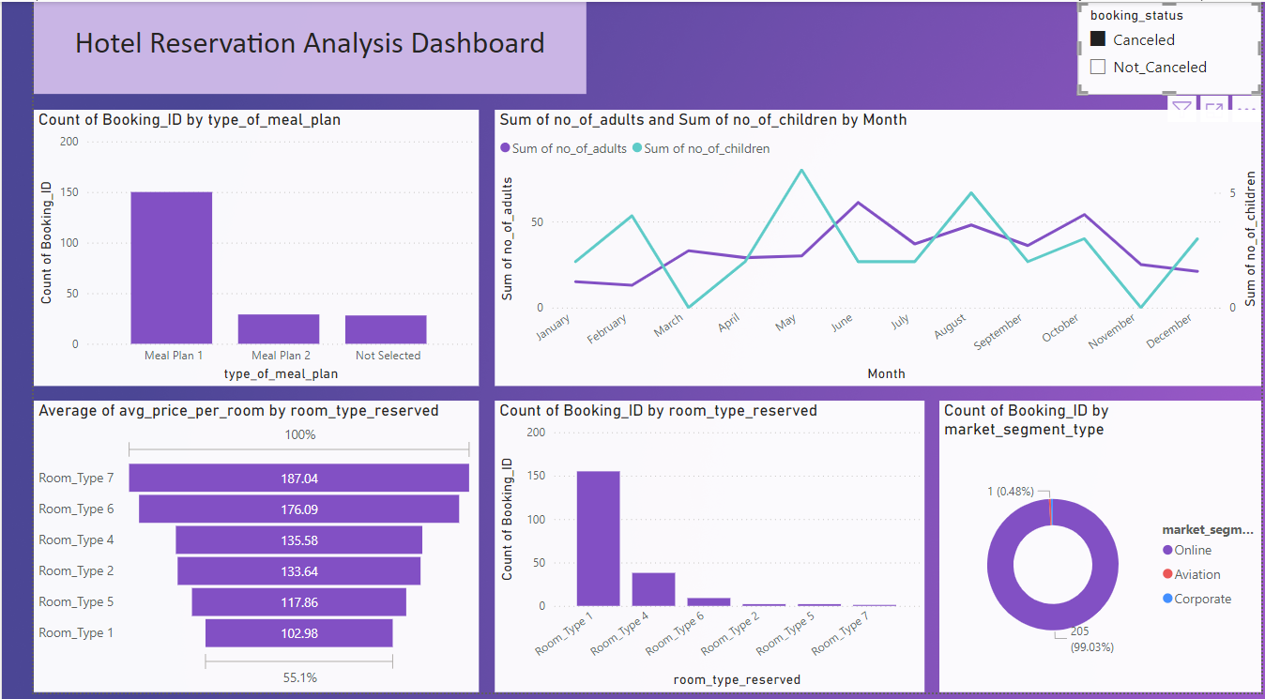
Dashboard

Slide 7
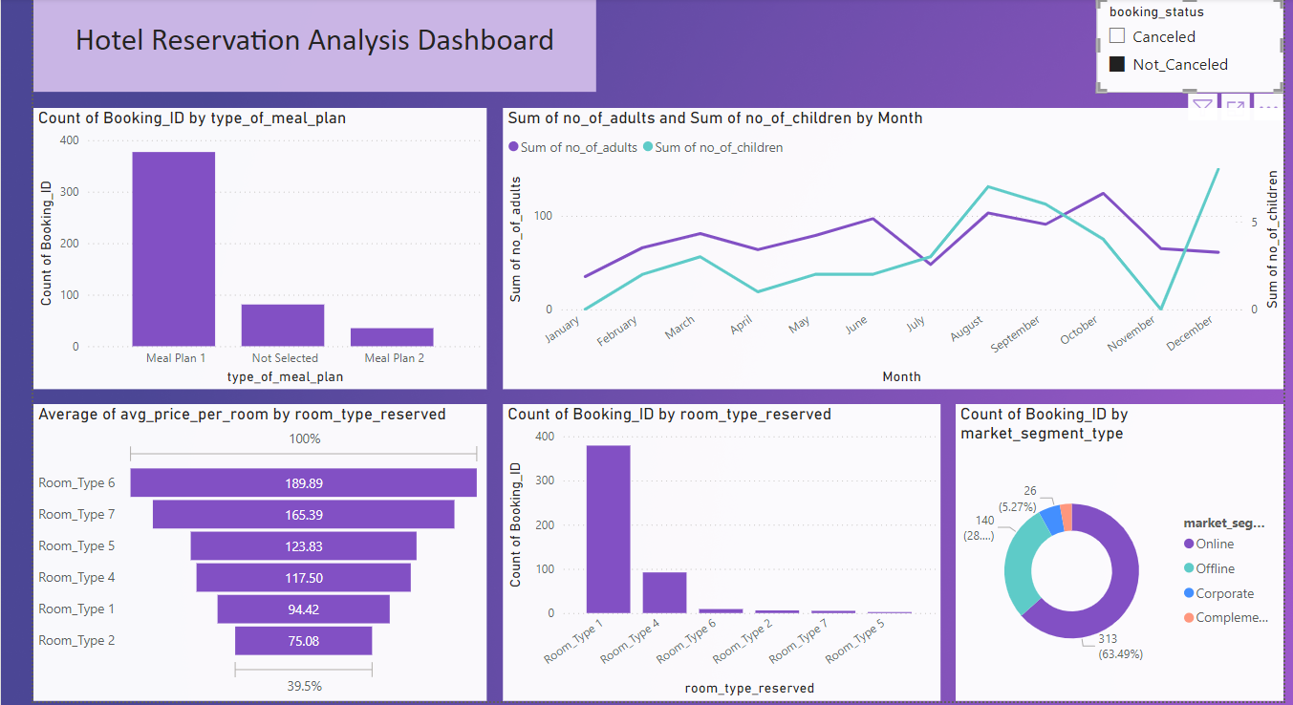
Dashboard

Slide 8
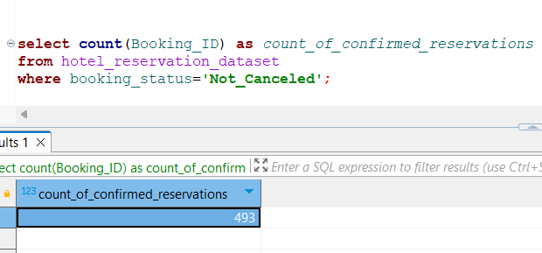
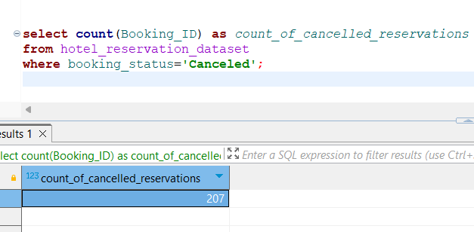
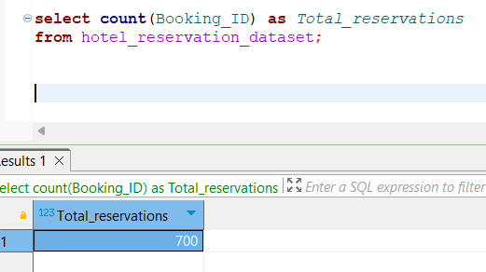
Results and Findings
Question-1: What is the total number of reservations in the dataset?

Slide 9
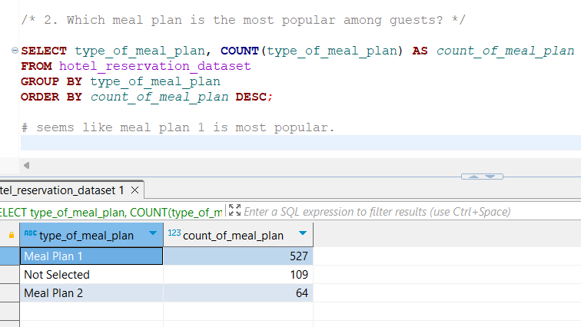
Results and Findings
Question-2: Which meal plan is the most popular among guests?

Slide 10
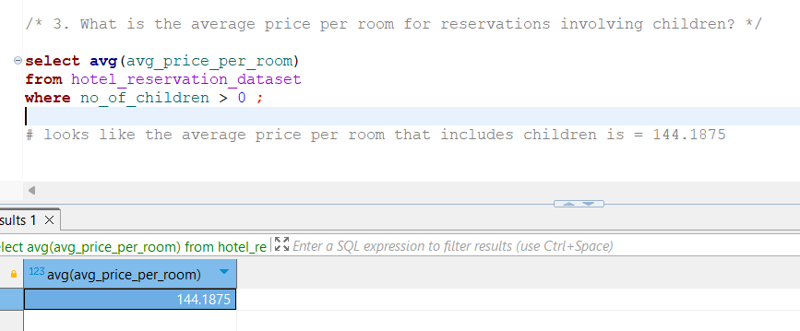
Results and Findings
Question-3: What is the average price per room for reservations involving children?

Slide 11
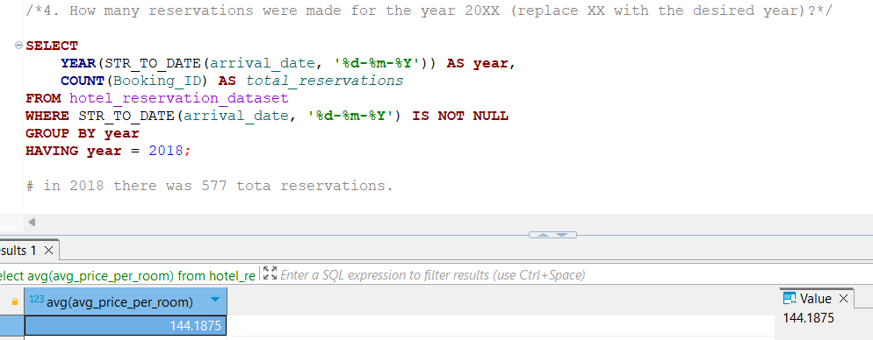
Results and Findings
Question-4: How many reservations were made for the year 20XX (replace XX with the desired year)?

Slide 12
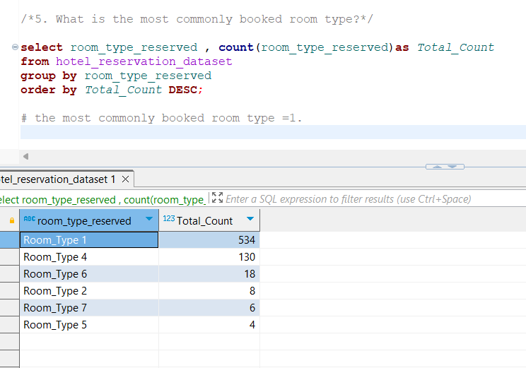
Results and Findings
Question-5: What is the most commonly booked room type?

Slide 13
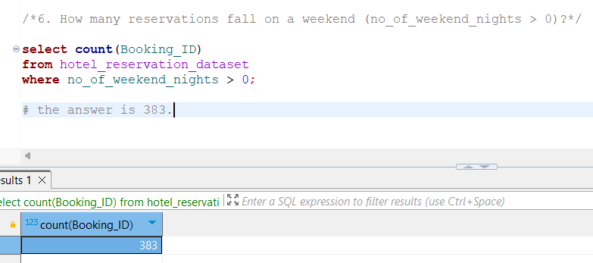
Results and Findings
Question-6: How many reservations fall on a weekend (no_of_weekend_nights > 0)?

Slide 14
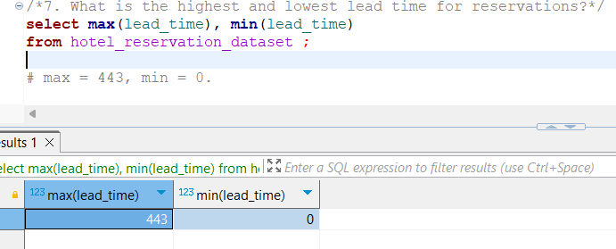
Results and Findings
Question-7: What is the highest and lowest lead time for reservations?

Slide 15
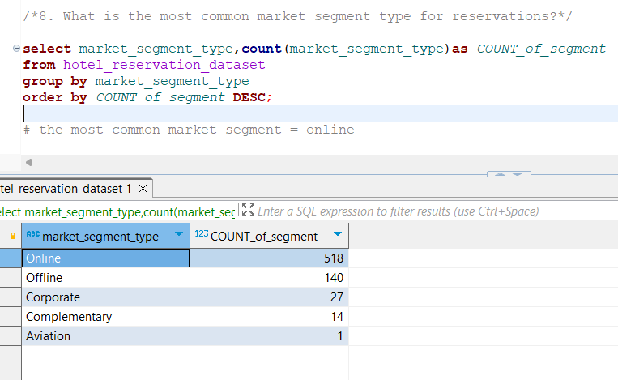
Results and Findings
Question-8: What is the most common market segment type for reservations?

Slide 16
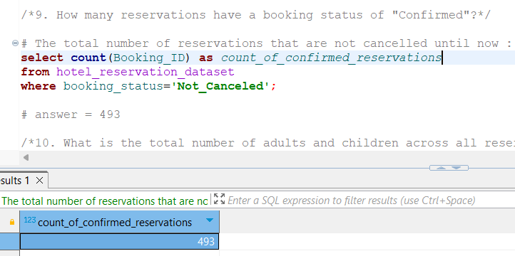
Results and Findings
Question-9: How many reservations have a booking status of "Confirmed"?

Slide 17
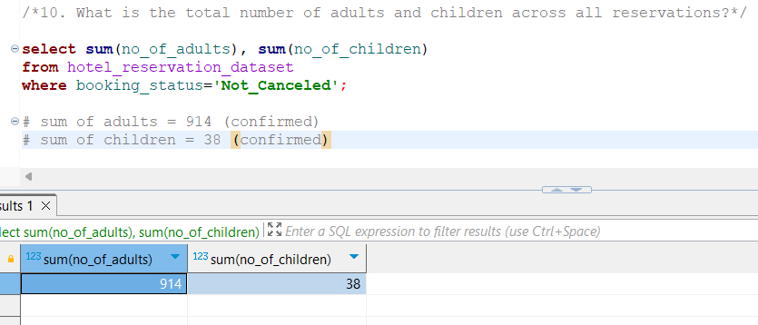
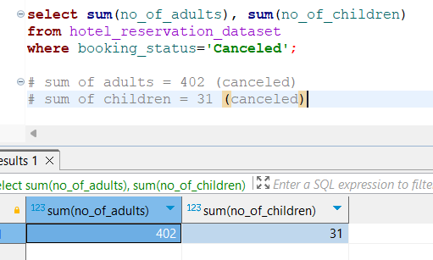
Results and Findings
Question-10: What is the total number of adults and children across all reservations?

Slide 18
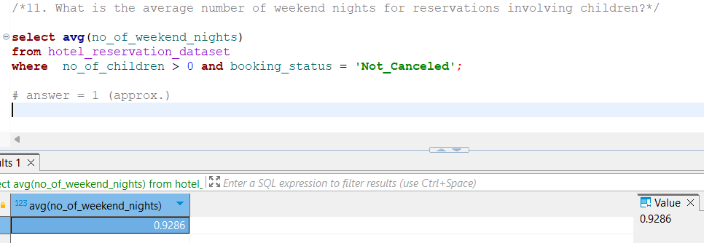
Results and Findings
Question-11: What is the average number of weekend nights for reservations involving children?

Slide 19
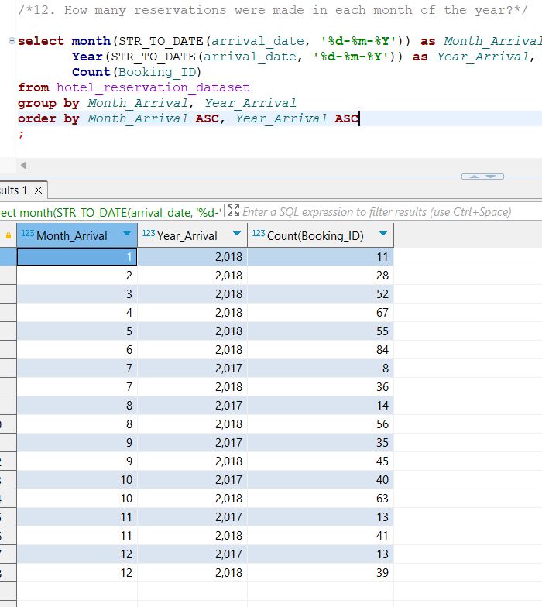
Results and Findings
Question-12: How many reservations were made in each month of the year?

Slide 20
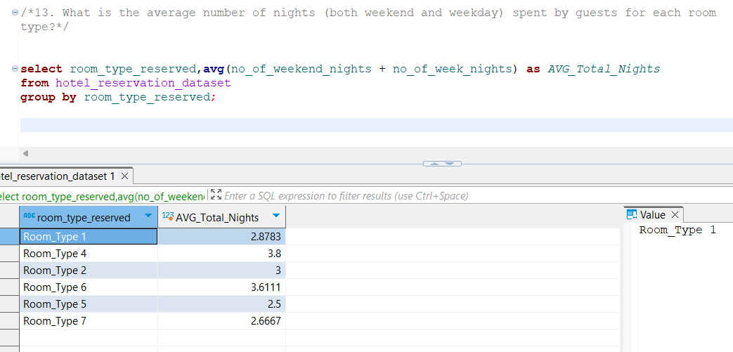
Results and Findings
Question-13: What is the average number of nights (both weekend and weekday) spent by guests for each room type?

Slide 21
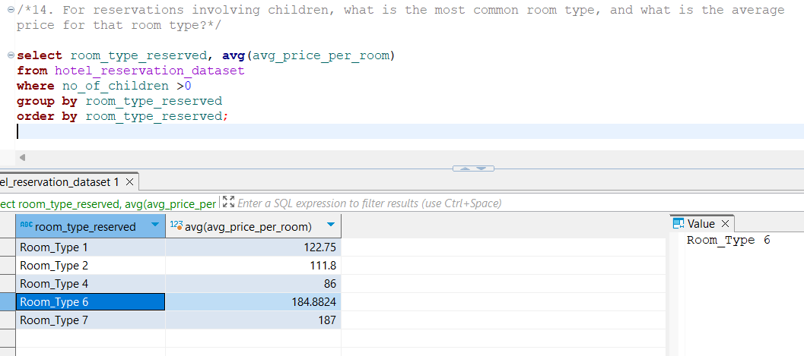
Results and Findings
Question-14: For reservations involving children, what is the most common room type, and what is the average price for that room type?

Slide 22
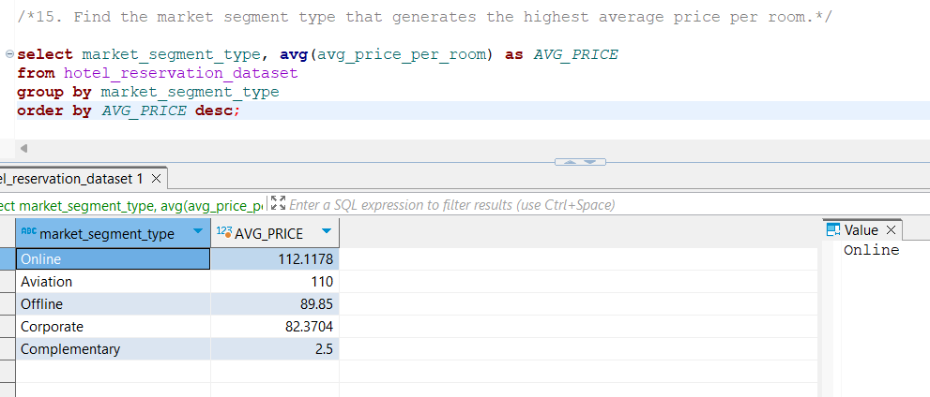
Results and Findings
Question-15: Find the market segment type that generates the highest average price per room.

Slide 23
THE END

